Slide 1
Python
PII: Functions
Objective: DRY

Slide 2
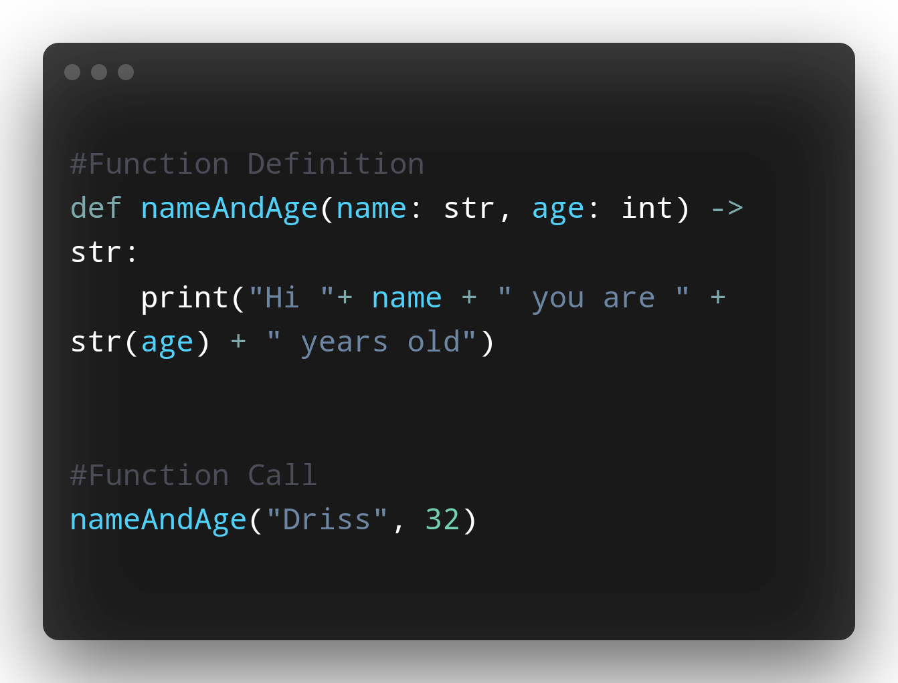
Example 1

Slide 3
What the hell are they?
Block of statements that relate to one another whose goal is to complete a specific task
Enable me to use them over and over again
For example, I want to add two numbers
Instead of defining two vars and adding them every time
I can create a template which takes two ints and returns their sum
Some functions MAY OR MAY NOT RETURN A VALUE
Any logic executed on an object within the function gets reflected outside it
i.e. Any modifications made within your parameters inside the function gets reflected outside
For example, I have listA defined within my function I add to it
Then I make a call to my function and invoke the append method
All the items that were inside my function defintion join with the new members I added

Slide 4
<! Hold Your POSITION />
On the right I am defining a function that takes positional arguments
That means in my function call Driss holds the position for name and the value of 32 holds the position for age

Slide 5
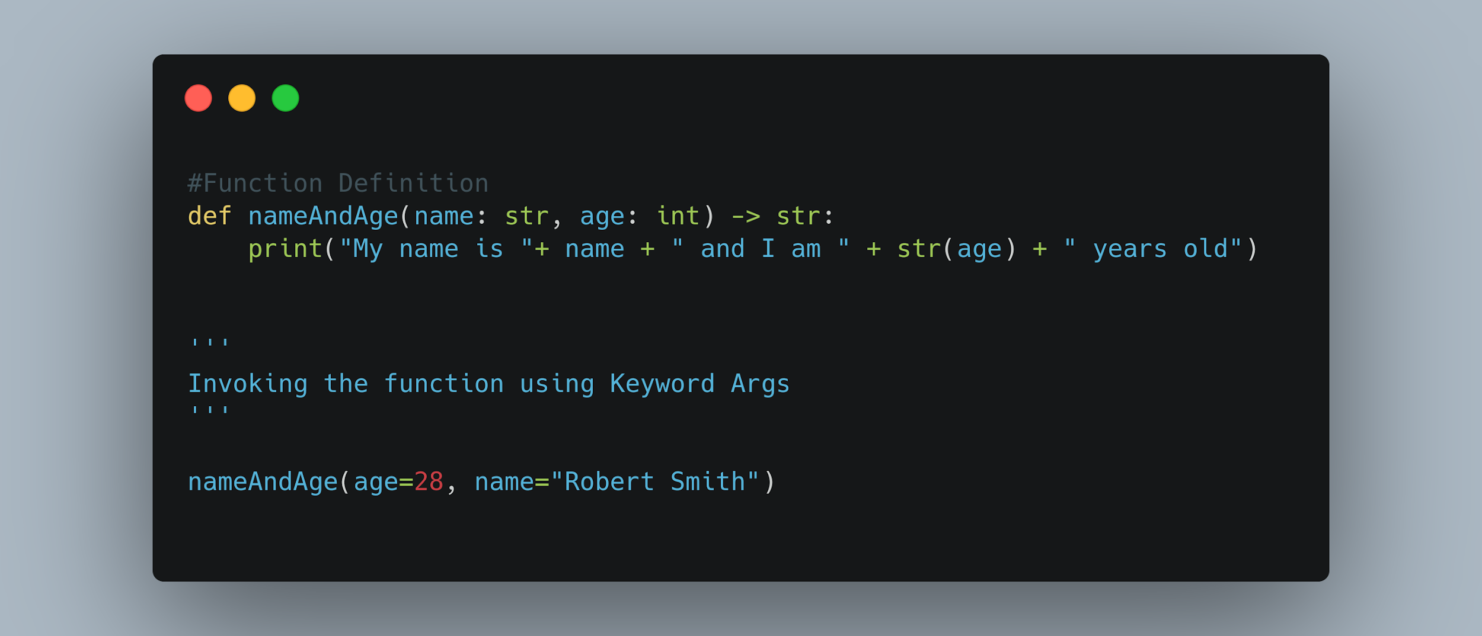
<! Keyword To Get
Access To The Property />
In Python the second type of arguments are called Keyword Arguments
Python allows me to make function calls using keyword arguments
When using keyword arguments order DOES NOT matter in contrast to positional arguments

Slide 6
None
When you want to give some flexibility to the user when invoking a function set the parameter to None
This will make the 2nd field optional and fire the function error free

Slide 7
Rules To Remember
Python reads line by line therefore if you define a function on line 8 you CANNOT make a call to it on line 3.
This will generate a Runtime Error
When Naming:
Use lowercase and underscores to be more descriptive
Never use leading special symbols
Never use reserved keywords(e.g. is, break, class, True, del, def, etc.)
Do not forget about case sensitivity
VarOne IS NOT the same as varOne

Slide 8
If you <default /> to the bank in Morocco you will not sleep
In Python functions have the ability to be defined with default values
This will allow the default values to hold the values of the arguments that were not
passed in
To use default values use the assignment operator = and give the default value you want
In Python you must remember either you have a function with every single argument having a default or none
In your function defintion you cannot have parameterA having a default value and parameterB not having a default value

Slide 9
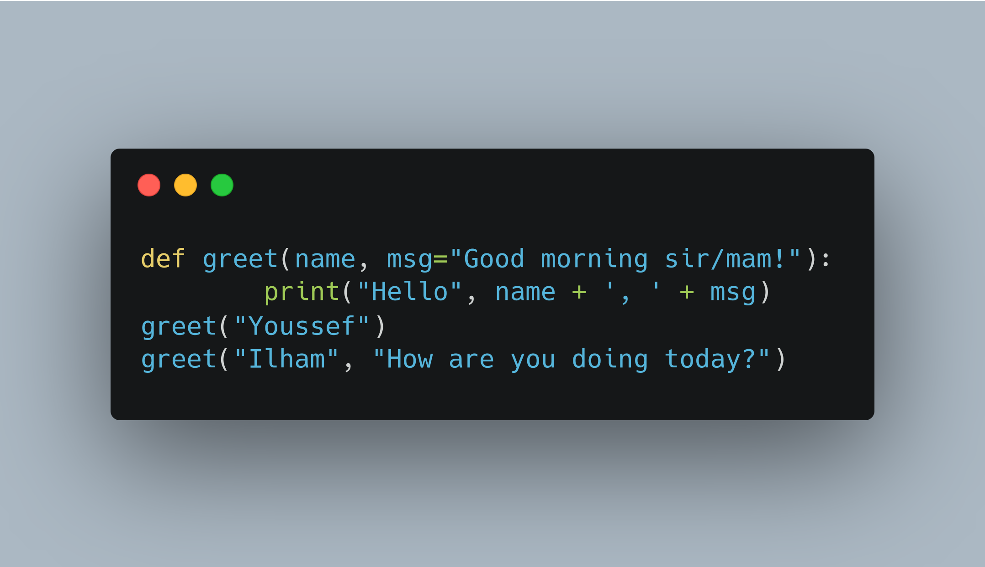
Default Parameters

Slide 10
Thank you

